Slide 1
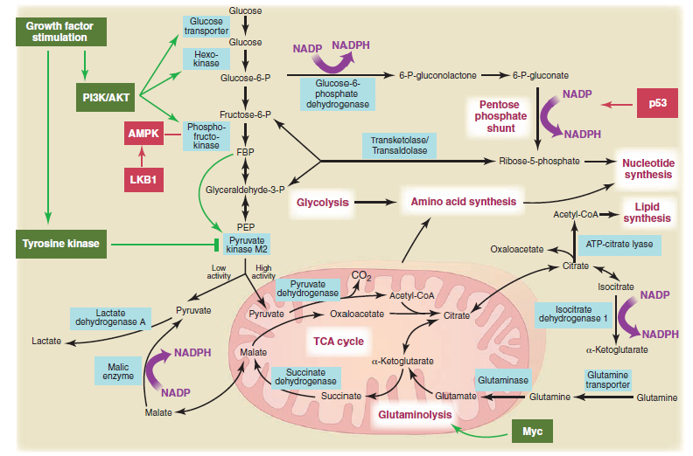
Key functions of IDH for anabolic metabolism & redox homeostasis
Citrate
Isocitrate
Idh1/2
NADP⁺
NADPH
Succinate
α-KG
Glutamine
-IDH1/2 interconvert isocitrate and aKG; One of the four NADPH producing enzymes (G6PDH, 6PGDH, ME).
-Generation of the NADPH required to sustain many anabolic pathways (fatty acid elongation, lipid synthesis and cholesterol synthesis) and for the regeneration of reduced glutathione and thioredoxin as cellular defense against oxidative damage.
-Both isoforms are crucial for proliferation of glutamine-dependent cells
Van Heiden et al. Science. 2009.

Slide 2
IDH1 in AML Cells?
✔ ICDH activity two-fold higher in AML compared to normal cells, while G6PDH, 6PGDH, LDH, GAPDH decreased in AML blasts
Belfiore et al. 1975; Rabinowitz 1966; Ghiotto et al. 1963.
✔ IDH1 and ME1 is over-expressed in AML LSC compared to normal HSC
Gentles et al. 2010; Saito et al. 2010.
ICDH activity
IDH RNA expression

Slide 3
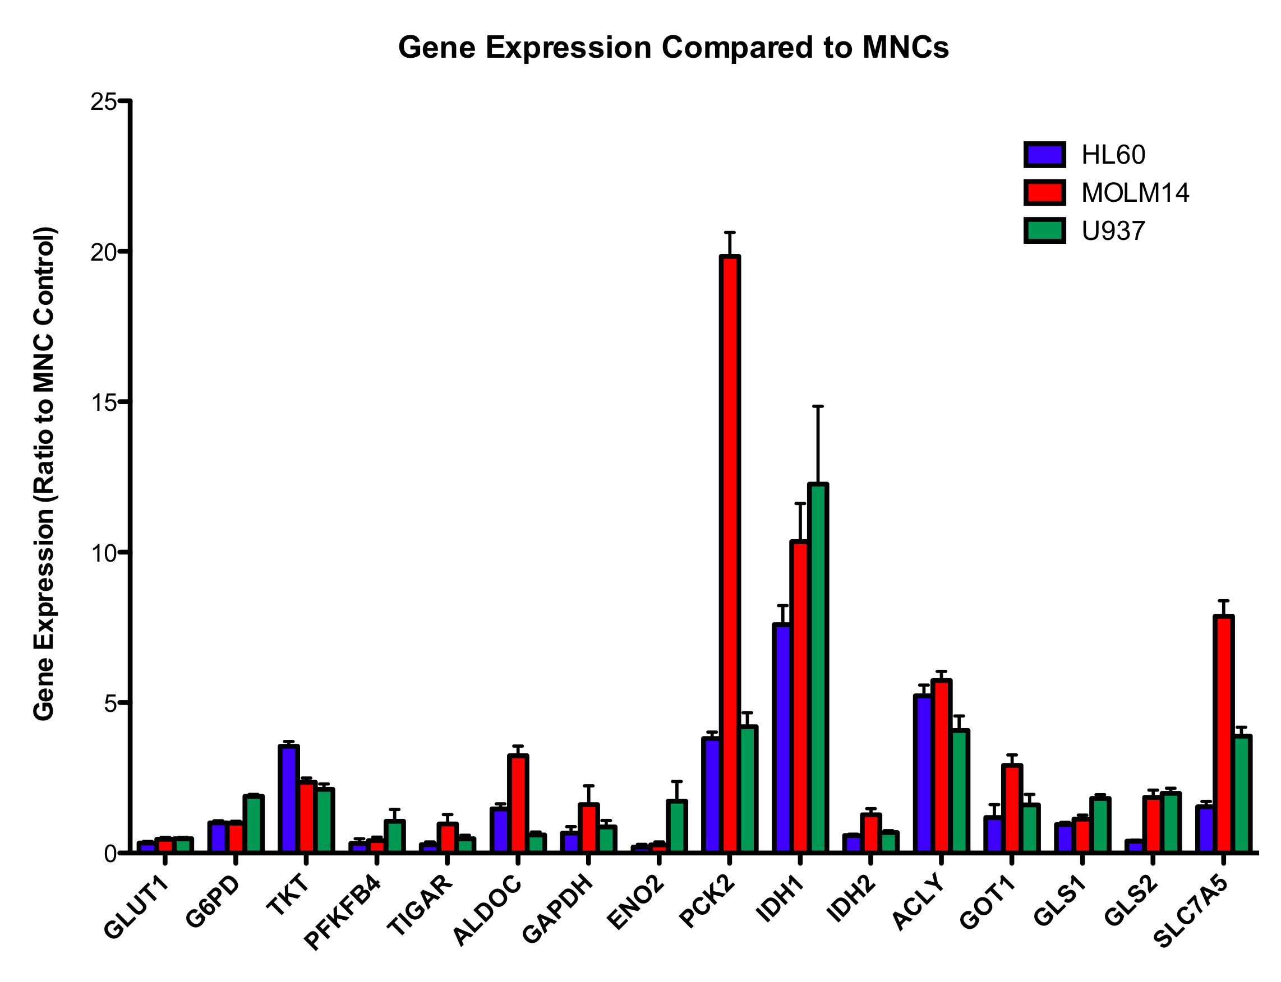
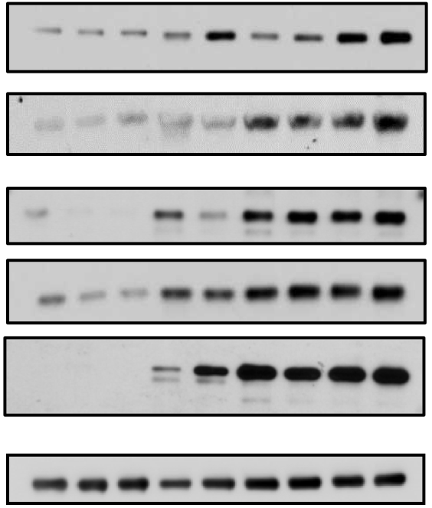
IDH1 is highly expressed in AML cell lines compared to normal MNCs, suggesting that IDH1 may be a key metabolic regulator
PBMNCs
AML cell lines
MV4-11
NHV02
molm14
NHV01
NHV03
KG1a
KG1
HL-60
U937
IDH1
Actin
Estelle, Sarah

Slide 4
Comparaison de l'activité IDH1-NADPH des cellules leucémiques avec des cellules normales
 | Ghiotto et al (1963) | Rabinowitz (1966) | Belfiore et al (1975)
ICDH | Leucémie aiguë:▲ | ▲ x1,5* ▲ x2,5** ▲ x2,0*** | = * ▲ x2,0**
G6PD | Leucémie aiguë:▼ | ▲ x1,5* ▼ x1,3** ▼x6,5*** | = * ▼ x2,5**
6PGD | Leucémie aiguë:▼ | ▼ x8,0* ▼ x1,5** ▼ x7,5*** | = * ▼ x1,5**
GAPDH |  | ▼ x3,0* ▼ x1,25** ▼ x2,5***
Ces observations suggèrent que la diminution des enzymes PPP dans les LAM confirme l'importance et la dépendance des cellules à l' ICDH et au métabolisme du citrate/glutamine pour générer des réactions de biosynthèse de NADPH et de contrôle redox.
* blastes myéloblastiques comparés aux monocytes
**blastes myéloblastiques comparés aux lymphocytes de patients ou
***blastes myéloblastiques comparés aux granulocytes de patient ou
**myéloblaste de patients LAM comparés aux
* myéloblaste de patients LAM comparé aux leukocytes normaux

